Slide 1
Unit 2 The universal language
Integrated skills (II)
叶婷 江苏省通州高级中学

Slide 2
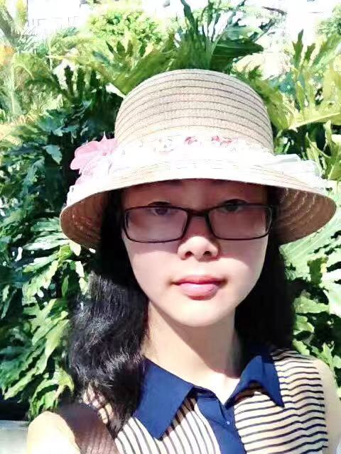
叶婷
中小学一级教师
南通市中青年名师张淳工作室成员
曾获“一师一优课、一课一名师”部级优课
南通市高中英语优课评比二等奖
通州区教学“六认真”先进个人

Slide 3
Lead-in
Have you heard about “Beatlemania”?
Beatlemaina is a phenomenon that people show great craze about the Beatles, a world famous British rock band.
Why are people crazy about singers or bands?
• They have their unique charms.
• They are being run by big businesses, who are doing everything they can to sell them to the public.
• …
?
Do you have a favourite singer or band?

Slide 4
Class work
Basic information
name
A singer or band
family
background
…
work experience

Slide 5
Features and influences
Features:
A singer or band’s innovations in music or performance
Influences:
A singer or band’s personalities have a good impact on people or their music becomes popular and encourages numerous people.

Slide 6
Your unforgettable memory
• The first time you listened to their songs, you felt excited or moved.
• When you felt down, you listened to their songs.
• …

Slide 7
Talk in pairs
Talk with your partners about
your favourite singer or band
Your talk should include this singer or band’s basic information, features, influences and your unforgettable memories related to the singer or band. You can use the following questions.

Slide 8
Questions
Who is your favourite singer or band?
What do you like about the singer or band?
What are your favourite songs by the singer or band?
How do you feel when you listen to them?
What are the highlights of the singer’s or band’s music career?
Can you think of a memorable time when you listened to the singer’s or band’s songs? What was it like?

Slide 9
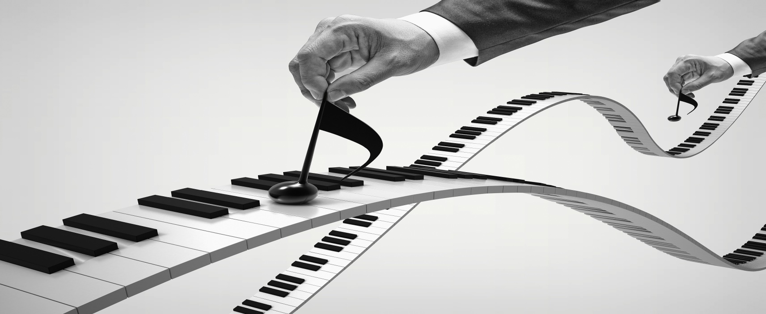
Pay attention to the expressions
Expression 1: tell me more about …
Expression 2: Could you tell me more about …?
Which is better? why?

Slide 10
If you want to know more about your partner’s favourite singer or band, use the following expressions.
Expressions
Asking for further information
Could you tell me more about ...?
I wonder if you could say more about ...
I’d like to know more about ... Could you tell me something about that?
I’m really interested in ... Could you tell me a little bit more?

Slide 11
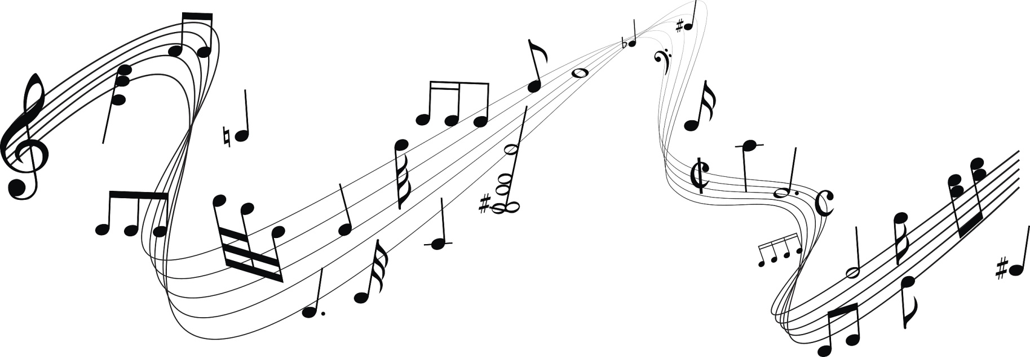
Presentation
Present your dialogue in front of the whole class.

Slide 12
Writing
Structure
Review Part B
 | The writer’s love for the Beatles
 | A simple introduction to the Beatles and their popularity
 | The writer’s star-struck journey with the Beatles and the Beatles’s influence on him
Main idea
Part 1
Part 2
Part 3

Slide 13
Develop your writing
Main idea
Part 1
Part 2
Part 3

Slide 14
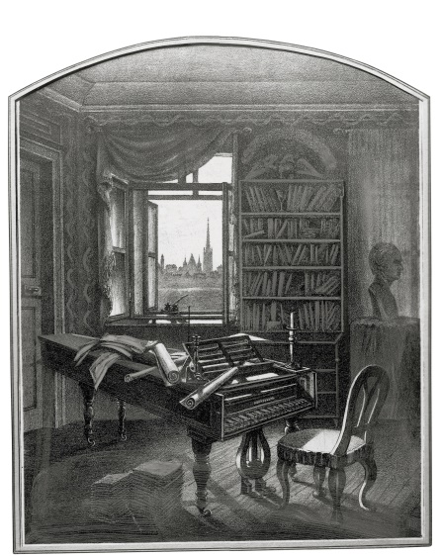
Part 1
My favourite singer/band is __________. At an early age, he/they ____________. Several years later, ______________.

Slide 15
Part 2
The main reason he/they becomes/become my favourite singer/band is __________. He/They differed from other singers/bands in __________. He/They immediately grabbed the attention of people. _____________.

Slide 16
Part 3
I remember the first time I listened to his/their music. _______________________. I still recall feeling ____________________ when I heard his/their voice. __________________. Ever since, if I am feeling ______________, his/their music _________________.

Slide 17
Language
Tip
Use words about emotions to tell readers how you feel. Adjectives expressing positive feelings include amazed, delighted, joyous, overjoyed, cheerful, excited, satisfied, relieved, energetic, calm and peaceful. You might use such words as lonely, anxious, nervous, bored, depressed, frustrated, upset, worried and stressed when you describe how the music helps you get rid of negative feelings.

Slide 18
example
I still recall feeling amazed and delighted when I heard Jackson’s one-of-a-kind voice: the pleasant tone and catchy signature sounds he is famous for. Singing and dancing to Michael’s songs became a fun family tradition. Ever since then, if I am feeling lonely or upset, his music has come to my rescue and turned my frown upside down. That is the power of the King of Pop.

Slide 19
Finishing your writing
Pay attention to the content, the structure, and the language of your writing.

Slide 20
Checking your writing
Check your writing and exchange drafts between you and your partner. Pay attention to the following aspects:
□ Punctuation □ Spelling □ Grammar
□ Choice of words □ Style (formal/informal) □ Structure

Slide 21
Checking your writing
Self-review
What mistakes do you find in your writing?
How can you correct them?

Slide 22
Checking your writing
Peer review
What suggestions does your partner give to improve your writing?
How can you improve your writing?

Slide 23
Homework
Improve your writing and read more articles written by your classmates.

